Slide 1

ECE 382V: QUANTUM COMPUTING SYSTEMS:
A SOFTWARE/ ARCHITECTURE PERSPECTIVE
SURFACE CODES
POULAMI DAS
ECE, The University of Texas at Austin

Slide 2
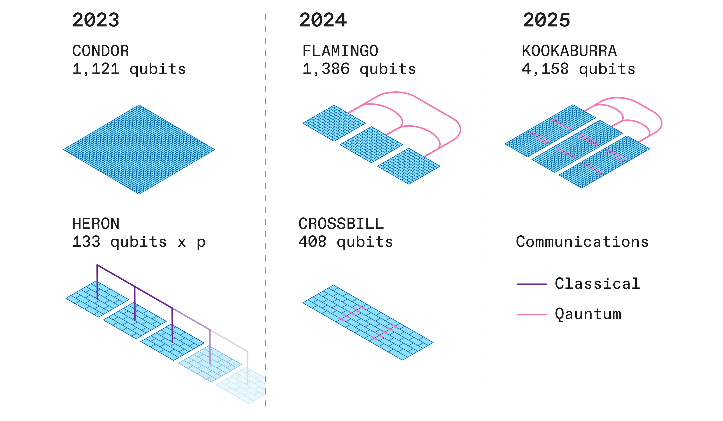
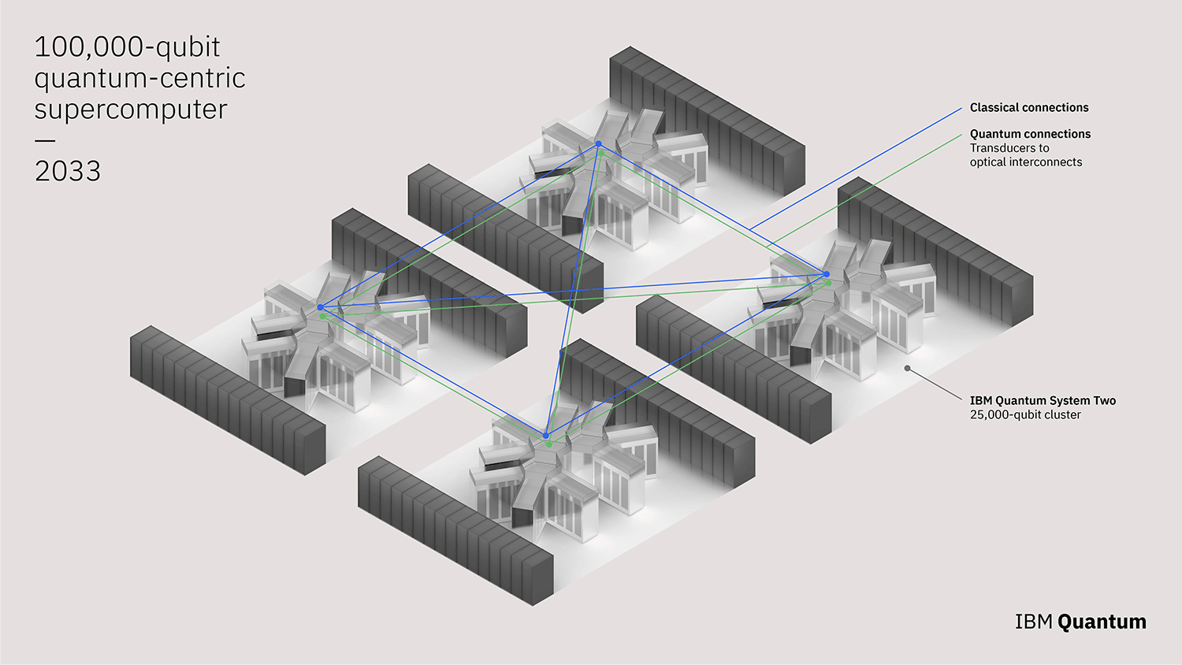
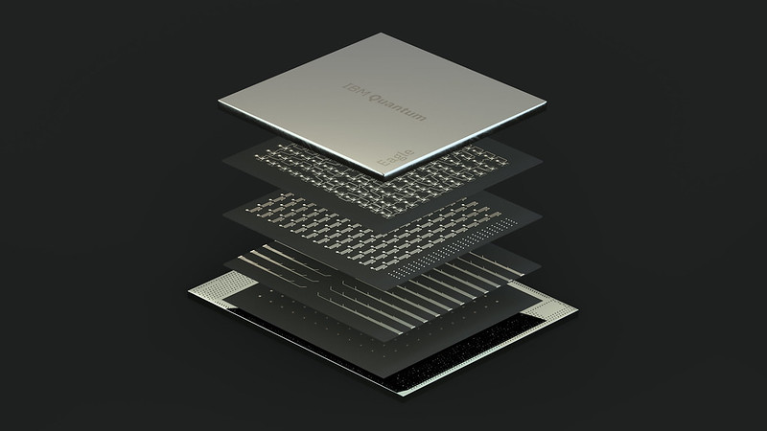

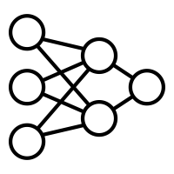
Applications To Devices Gap
~400 qubits
p = 0.5%
~4000 qubits
p = 0.1%
~100K qubits
p = 0.01%
Applications-at-scale
p < 10⁻¹⁵
2023
2026
203X
Goal
Significant gap in error rates!
Most practical quantum applications require error-rates far below device error-rates

Slide 3



Quantum Error Correction- 101
Data qubits store information in entangled state, parity qubits detect errors
One bit-flip error
No error → Parity is all-zeros
One error → Parity is non-zero
(Hamming Weight 1)
0
B
One error → Parity is non-zero
(Hamming Weight 2)
1
1
1
0
0
1
1
0
0
A
1
1
C
One error → Parity is non-zero
(Hamming Weight 1)
Syndrome
Syndrome Extraction
Decoding
What about phase errors?

Slide 4
Surface Codes
Surface codes are widely recognized as the most promising QEC candidate
Logical Qubit
Correct more errors with increasing redundancy
(distance)
Logical error-rate decreases exponentially with increasing redundancy

Slide 5


Overview Of Quantum Error Correction Steps
QEC involves syndrome (parity) extraction and decoding to identify errors
Decoder
1
Instructions to generate syndrome
3
Correction
2
Syndrome
2
Send syndrome to decoder
01…….01
Control
Processor
Readout
Interface
Did an error occur?
1
Where did the error occur?
QEC
Instructions
What was the type of error?
Qubits
3
Send correction to control processor
Errors are actively corrected before they can accumulate

Slide 6
Quantum Error Correction Using Surface Codes
More redundancy enables us to tolerate more errors (longer chains of errors)
Logical Qubit
X stabilizers
Data qubits
Z stabilizers
X Error
}
Y Error
Z Error
Regular
Surface Code
Rotated
Surface Code
Distance = 3
Distance = 3
Distance = 5
The distance is determined from the gap between the target (application) and device error-rate

Slide 7
How To Decode Errors?
Decoding can be translated into a graph matching problem
Z-Decoding Graph
X-Decoding Graph
Code
Lattice
Decoding Graph
There are other approaches to decode errors as well

Slide 8
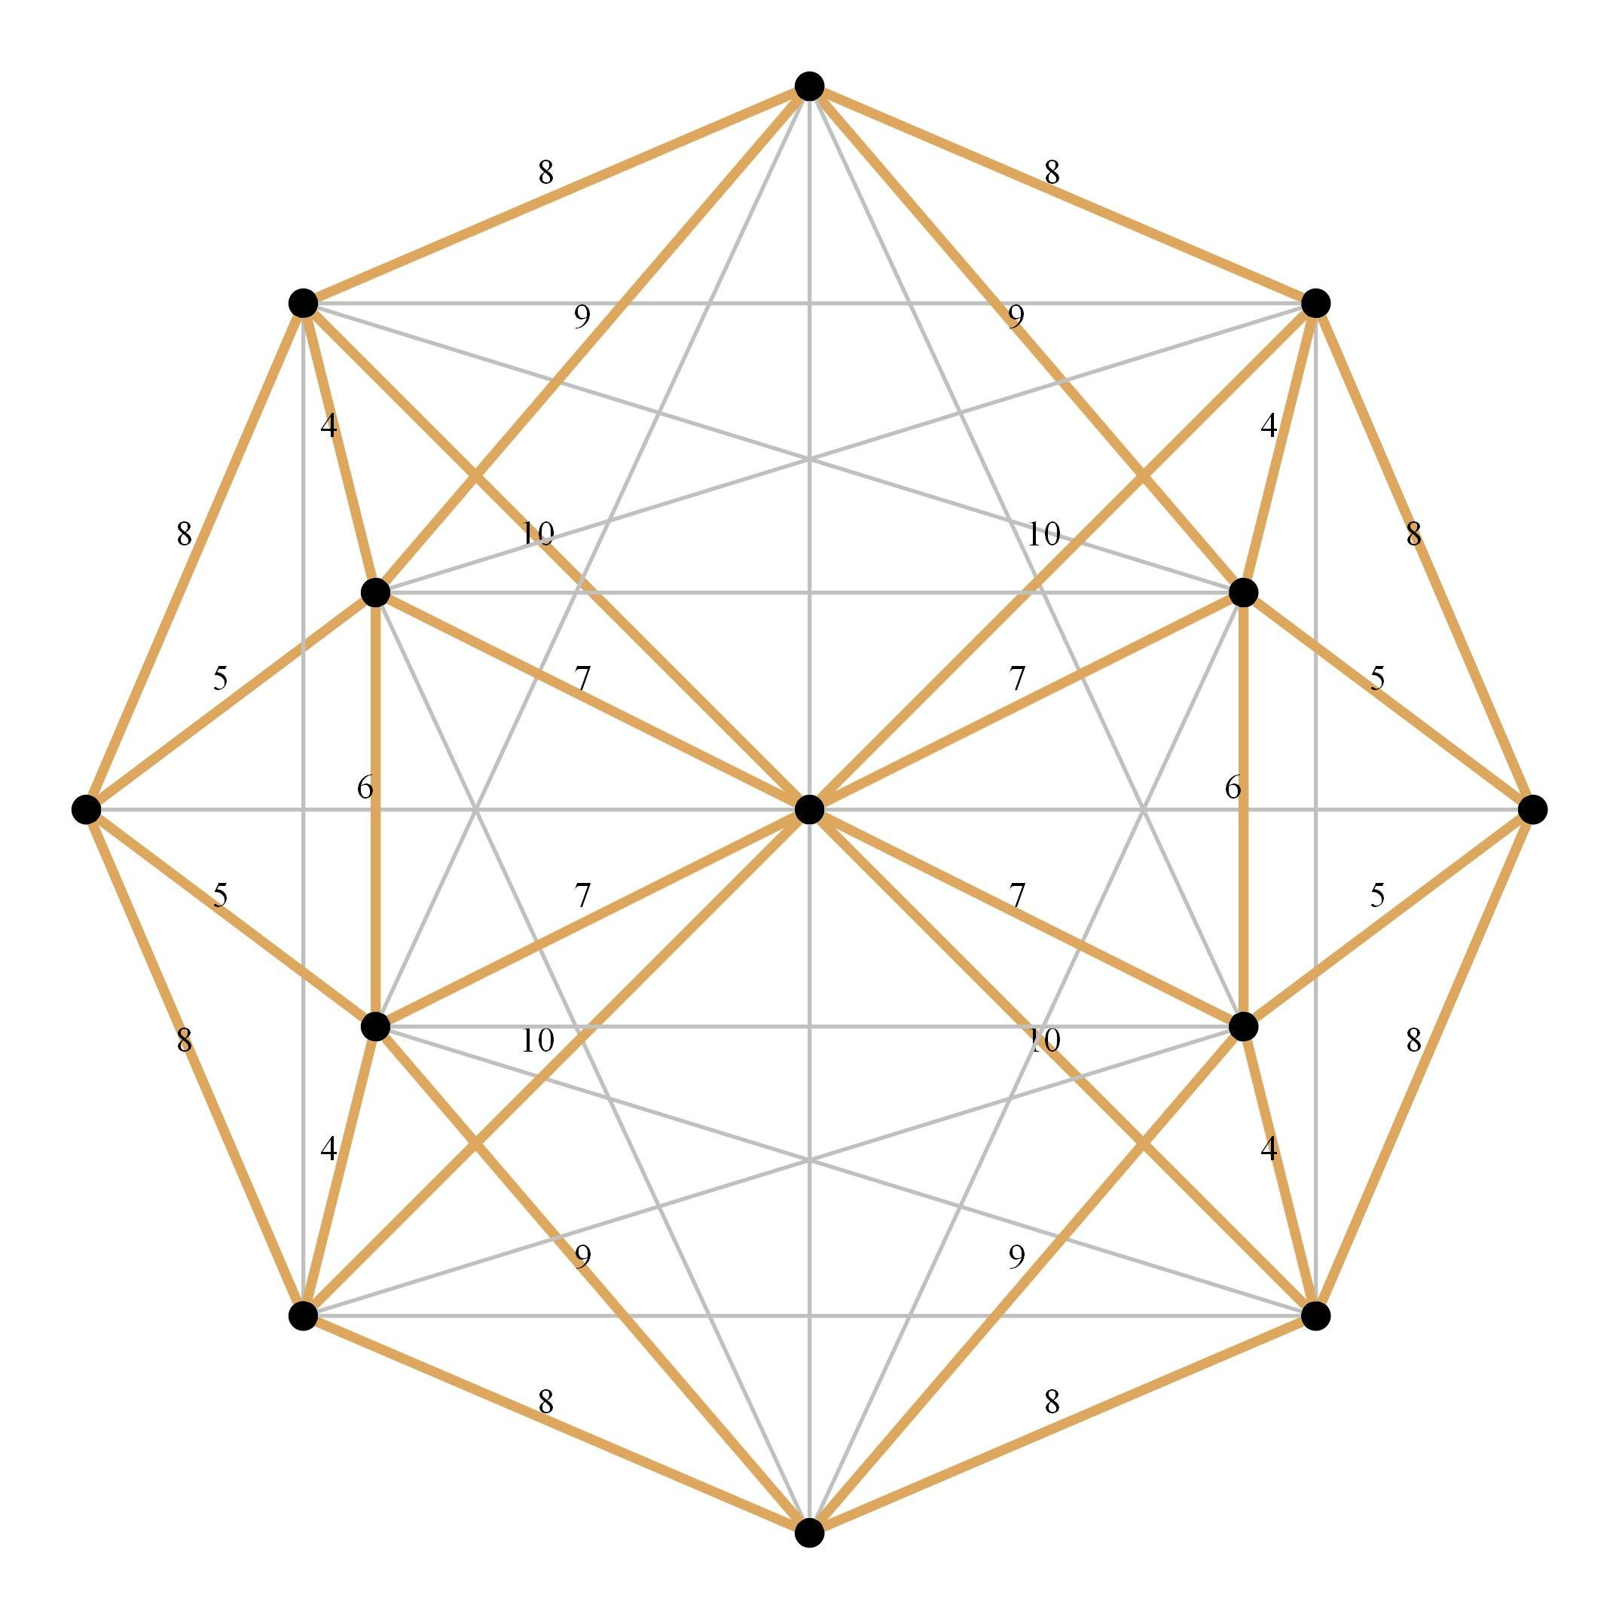



Overview Of Decoding Approaches
Graph Pairing
Union-Find
Minimum Weight Perfect Matching
Maximum Likelihood
Belief Propagation
Others
Lookup
Table
Machine
Learning
The MWPM algorithm is widely regarded as the gold-standard for decoding surface codes

Slide 9
Overview Of QEC Process
1
X Syndrome: 0000
Z
Decoder
Logical
Qubit
X
1
0
Z
Z Syndrome: 1010
Correction
Syndrome Extraction
Decoders must identify errors accurately or they may introduce errors themselves

Slide 10
Syndrome Extraction Is Imperfect
P
X
M
0
1
X
Accuracy
D
D
D
X
D
Overheads
1
Handle errors in syndrome extraction
2
Handle complex patterns of errors
How do we handle errors in syndrome extraction?

Slide 11
Decode Multiple Syndromes Simultaneously
Errors that occur on (1) data qubits and (2) during syndrome extraction
Errors on data qubits: space
Measurement errors in syndrome extraction: time
Gate errors in syndrome extraction: space-time
P
M
D
D
D
Decoding-> Matching on a 3D graph with O(d) rounds
Decoders decode ‘d’ consecutive syndromes to tolerate errors during syndrome extraction

Slide 12
Real-Time Decoding
Decoding must be in real-time to prevent the accumulation of errors
Required latency depends on the qubit technology
Real-Time Decoder
At least equal to the time to extract a syndrome
~1μs
Real-time decoding prevent the accumulation of errors and protects logical qubits

Slide 13
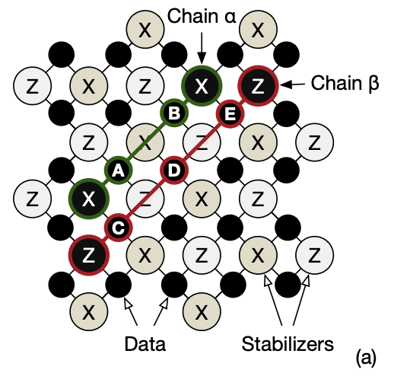
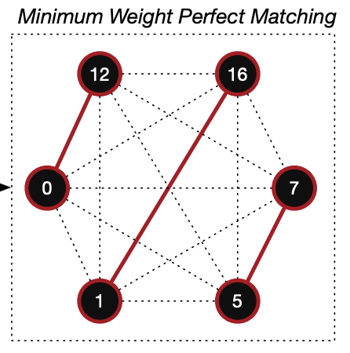
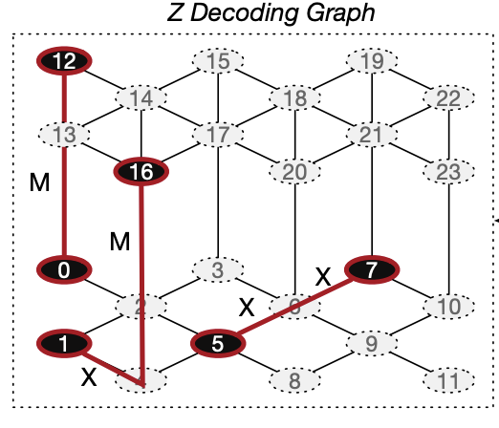
Minimum Weight Perfect Matching (MWPM)
Edges: Data qubits
Nodes: Parity qubits
1s ->failed parity checks
Fully connected graph
Edge weight-> probability that the two nodes connecting the edge flips
Solve for MWPM
MWPM: denotes the highest probability error event
Ideally, we want to identify the MWPM in real-time

Slide 14


Challenge: Software Decoders Are Too Slow
Real-time decoding (within a microsecond) prevents accumulation of errors
Software
Decoder
Room temperature
(Outside dilution refrigerator)
Slow
Decoder
Correction
Syndrome
Control
Processor
Readout
Interface
QEC
Instructions
Qubits
15-20 mK
(Inside dilution refrigerator)
Traditionally, software decoders are used for decoding
Software decoders are too slow for real-time decoding

Slide 15
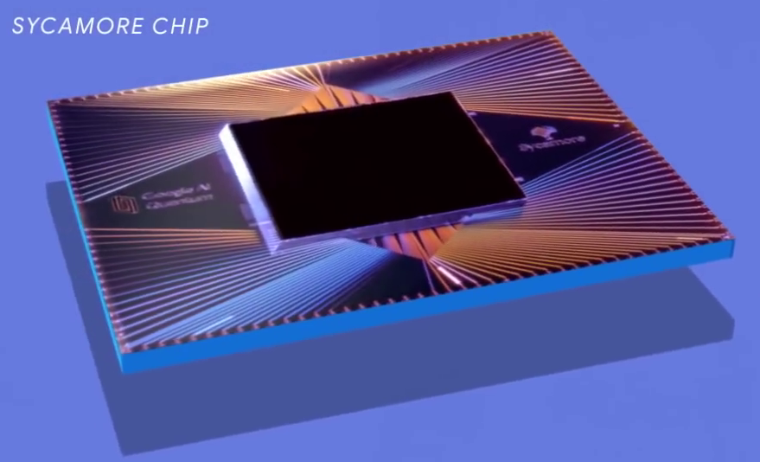
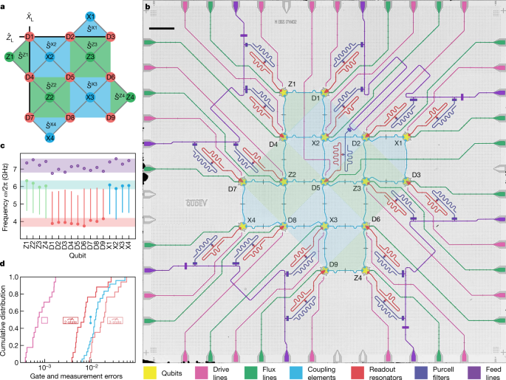
Limitations Of Software Decoding
Distance 5 Surface Code
Google, 2023
Distance 3 Surface Code
Wallraff Group, 2022
Real-time decoders are crucial for QEC

Slide 16
REAL-TIME Decoding OF SURFACE codes
How can we decode surface codes in <1 us and achieve MWPM accuracy using hardware solutions?

Slide 17
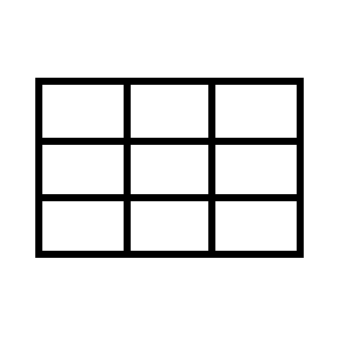

Use Lookup Tables Preloaded With MWPM
Software
Decoder
Lookup Tables
Replace software decoders with LUTs
Correction
Syndrome
Low-Cost
Control
Processor
Readout
Interface
Low-Latency
QEC
Instructions
Accurate
Qubits
FPGA-based
Poulami Das et al. “LILLIPUT: A Lightweight Low-Latency Lookup-Table Based Decoder for Near-term Quantum Error Correction”, ASPLOS 2022
LILLIPUT: A low-cost, accurate, and real-time decoder for practical adoption

Slide 18

Programming LUTs Of LILLIPUT
Program LUTs offline using software Minimum Weight Perfect Matching decoder
Offline Access
Lookup Tables
Preload LUT Data
Correction
Syndrome
Software
MWPM
Online
00000000000
Control
Processor
000…000
Readout
Interface
00100000100
000…001
QEC
Instructions
…
…
111…111
00000100100
Qubits
All Error Events
LUT Data
LILLIPUT programs the LUTs offline using MWPM and performs decoding online

Slide 19
Challenge: Memory Complexity Of LILLIPUT
LUT size grows exponentially with the number of syndrome bits
148 MB
Lookup Tables
238 KB
Syndrome
Correction
LUT size
832 B
8-bit
2⁸ = 256 entries
16-bit
2¹⁶ = 65K entries
2⁸
2¹⁶
2²⁴
24-bit
2²⁴ = 16.7 Million entries
[d=3]
[d=4]
[d=5]
Code distance
LUT sizes exceed FPGA on-chip memory

Slide 20

Not All Error Events Are Equally Likely
Distance Surface Code = 3
Physical error rate = 0.1%
0
0
No error (HW=0)
1
0
One error (HW=1)
1
1
One error (HW=2)
Uncorrectable
Logical error rate
Rare
1
1
One error (HW=1)
An error flips at most two parity bits of each type
Only store entries corresponding to correctable errors
Storing only entries for correctable errors are sufficient

Slide 21
LUTs Store Sparse Data
Can correct error chains
of length 1 only
Possible to assign errors
to only few data qubits at a time
Compress the LUT data
Compressed LUTs (CLUTs) store selective entries in compressed form

Slide 22
Performance Of LILLIPUT
Up-to 107x memory reduction with CLUTs
CLUTs have negligible impact on accuracy
42 ns latency, < 7% FPGA logic,
Sufficient up-to d=5
LILLIPUT decodes d=3 and limited form of d=5 in real-time

Slide 23
Rethinking MWPM And Matchings For Higher Distances
Nonzero Syndrome Bits
MWPM
a
b
Pair bits such that sum of edge weights is minimized.
a
b
d
c
d
c
W = -log(P(errors between c and d))
Probability
Lower weight
Matchings = O(n!)
Goal: Locate this highest probability error event or the corresponding matching

Slide 24
Exhaustive Search For MWPM?
The number of perfect matchings scales O(e^{HW}).
Look at small HW.
c
d
a
b
e
f
Only one option
Three options
i
z
j
5
* 3
* 1
= 15 options
Easy for exhaustive search
y
k
x
Insight 1: Low HW syndromes are easy to decode accurately

Slide 25
Matching Problem From Perspective Of Hamming Space
P(HW > 10) < LER
Hamming weight (p = 10⁻⁴) | d = 3 prob. | d = 5 prob. | d = 7 prob.
0 to 2 (trivial) | 0.99 | 0.99 | 0.99
3 to 10 (low) | 4.2e-5 | 3.2e-5 | 0.01
>10 (high) | 0 | 0 | 4e-9
Logical error rate (LER) | 8.1e-6 | 1.3e-7 | 6e-9
Decreases exponentially
Only need to decode HW ≤ 10
Just exhaustively search for MWPM!
We only need to decode syndromes whose HW $≤$ 10
Notes:
We approach the problem of syndrome extraction through the perspective of Hamming weight.
First, we observe that for an error rate of 10^-4, syndromes with HW <= 10 comprise
all or almost all of the syndromes encountered during syndrome extraction.
We further observe that lower Hamming weights occur exponentially less often than higher Hamming weights.
Second, we observe that up to HW = 10, there are at most 945 possible perfect matchings. This low number, combined with the fact
That we need not decode HW > 10 implies that we can exhaustively search for the MWPM.
We leverage this fact to design Astrea to decode up to d=7.

Slide 26
Decoding HW 6 And Below With Astrea
HW ≤6 = ≤32ns
a
y
b
MWPM
x
c
d
Suhas Vittal et al. “Astrea: Accurate Quantum Error-Decoding via Practical Minimum-Weight Perfect-Matching”, ISCA 2023
Astrea can quickly decode syndromes with HW ≤ 6 in 32ns

Slide 27
Decoding HW 8 With Astrea
HW ≤6 = ≤32ns
HW 8 = 60ns
HW 8 Decoder
a
PM1
w
b
PM2
PM3
z
c
min
MWPM
PM4
PM5
y
d
PM6
x
PM7
Astrea pre-matches a pair of bits and uses the HW-6 decoder 7 times to decode HW 8

Slide 28
Decoding HW 10 With Astrea
HW ≤6 = ≤32ns
HW 8 = 60ns
HW 10 = 456ns
a
v
b
PM1
HW 8 Decoder
u
c
HW 8 Decoder
........
MWPM
z
d
y
e
PM9
x
Astrea accurately decodes d = 7 in real-time with only 10% of the FPGA

Slide 29
Coping With Larger Hamming Weights
a
Hamming weight = 16
~2M possible matchings!
P_{error} = 10^{-weight}
< LER
Filter!
~2000 matchings
Filter out large weights to reduce search space
Notes:
Currently,
*Astrea can handle d=7, p = 1e-4. If the physical error rate decreases,
then Astrea can handle higher distances. If the physical error rate increases,
Then Astrea cannot handle higher distances. This is because
Higher Hamming weights tend to appear more often at higher error rates and higher distances. Astrea cannot handle HW > 10, limiting its usability.
Thus, we want to extend Astrea to handle both higher distances and higher physical error rates.

Slide 30

Finding MWPM Post Filtering
Pre-matching
+
HW 6 MWPM
16
10
12
14
8
Bits left:
6
0
PM
MWPM
Prioritize lowest weights first to quickly find MWPM

Slide 31
Astrea-G :Design Overview
2 | 15 | 4 | 6
15 | 8 | 14 | 8
4 | 14 | 13 | 15
6 | 8 | 15 | 12
Greedy
Pre-match
8
4
Filter out if w > W_{TH}
15
HW ≤ 6?
Global Weight Table
+
40% FPGA Utilization
Minimum
t = 1μs
MWPM Register
STOP!
Astrea-G is the first decoder to accurately decode d = 9 in real-time

Slide 32
Performance Compared To MWPM
Equal accuracy to MWPM for d = 7
Within 2.5x of MWPM for d = 9
Astrea-G has comparable accuracy to MWPM, within 2.5x of its LER

Slide 33



Astrea-G Under Tighter Constraints
Extra time for:
Astrea-G works fine even below 1us

Slide 34


Summary
Lookup
Table
Surface codes
Real-time decoding
MWPM for d=3, limited d=5
MWPM up to d=9
Hardware decoders are becoming more common in QEC

